Slide 1





Enhancing Malaria Diagnosis with Machine Learning Algorithms

Slide 2
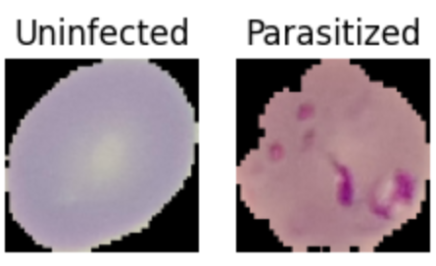
Introduction
In this project, the computer learns to detect Malaria in infected human cells using deep learning. The deep learning classifier accurately identifies parasitized and uninfected human cell images.

Slide 3
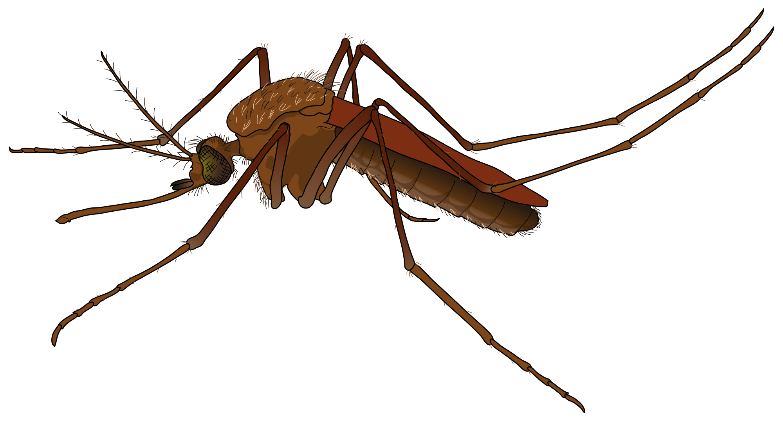
Dataset and Preprocessing
The dataset used for this malaria classification project was sourced from Kaggle, called “Malaria Cell Images Dataset” It contains cell images labeled as "Parasitized" (infected by the malaria parasite) or "Uninfected" (healthy).

Slide 4
Dataset and Preprocessing
The Directory Organization: The dataset is organized into two main folders: "Train" and "Test."
Train Folder: This folder is used for training the model. It contains two subfolders:
Parasitized: Contains blood smear images infected with the malaria parasite.
Uninfected: Contains blood smear images that are healthy.
Test Folder: This folder is used to evaluate the model after training. It also contains two subfolders:
Parasitized: Holds test images that are infected.
Uninfected: Holds test images that are healthy.

Slide 5
Dataset and Preprocessing
Image resizing, normalization, and data augmentation to enhance the data and improve the model's generalization.

Slide 6
Training and Testing Split
The dataset is split into training and testing sets based on the structure provided, with distinct "Train" and "Test" folders. The "Train" folder is used for training the machine learning model, while the "Test" folder serves as a final evaluation of model performance.

Slide 7
Model Architecture
The model is a Convolutional Neural Network (CNN). CNNs are highly effective for image classification tasks because they can capture spatial features through their specialized layers.

Slide 8
Model Architecture
ReLU (Rectified Linear Unit):
Used throughout the network in convolutional and dense layers to introduce non-linearity.
ReLU ensures only positive values pass while zeroing out negative values.
Sigmoid:
Used when you have binary classification.
The sigmoid function outputs a value between 0 and 1, making it suitable for representing probabilities.
The output can be interpreted as the likelihood of a sample belonging to the positive class in binary classification.

Slide 9
Training Process
Adam Optimizer: My code uses the Adam optimizer, which is popular due to its adaptive learning rate and fast convergence properties. It's particularly useful in deep learning because it combines the benefits of two other optimizers, RMSProp and SGD, ensuring stable and efficient training.
Learning Rate: The Adam optimizer typically uses a default learning rate of 0.001, which balances learning speed and convergence. You can confirm this value or any modifications if your code explicitly sets it.

Slide 10
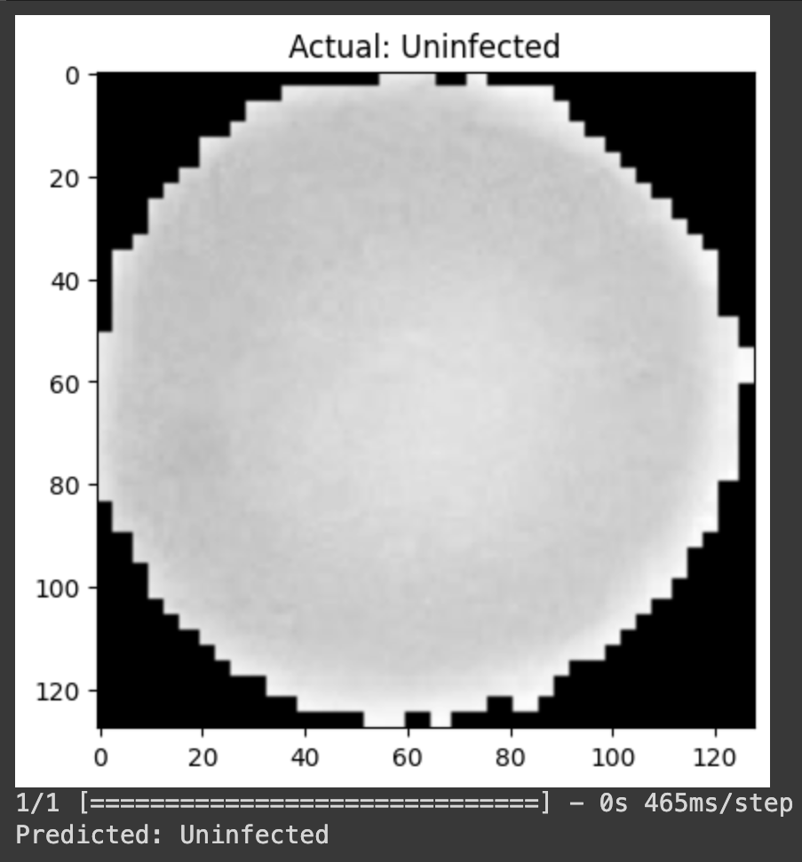
Training Process
Categorical Crossentropy: Since my model uses the softmax activation function, it also utilizes the categorical_crossentropy loss function. This loss function is used for multi-class classification, comparing predicted class probabilities with the true class labels.

Slide 11

Challenges and Limitations
Despite its potential, the implementation of machine learning in malaria diagnosis faces challenges such as data quality, interpretability, and resource constraints. Overcoming these limitations is crucial for the widespread adoption of machine learning in malaria diagnosis.
Machine learning algorithms can analyze large datasets of malaria-infected blood samples to identify patterns and predict infection. By leveraging advanced pattern recognition techniques, these algorithms can improve the efficiency and reliability of malaria diagnosis.

Slide 12

Conclusion
Machine learning algorithms can analyze large datasets of malaria-infected blood samples to identify patterns and predict infection. By leveraging advanced pattern recognition techniques, these algorithms can improve the efficiency and reliability of malaria diagnosis.

